Slide 1

Democratizing & Accelerating AI Through Automated Machine Learning AI Platform Team
#GlobalAINights
global.ainights.com

Slide 2

Agenda
Welcome Video
Why Automated Machine Learning
Automated ML Capabilities
How to Get Started

Slide 3

Welcome Video

Slide 4




Mission
Democratize AI
Accelerate AI
Scale AI
Enable Domain Experts & Developers to get rapidly build AI solutions
Improve productivity for Data scientists
Build AI solutions at scale in an automated fashion
Enable automated building of machine learning with the goal of accelerating, democratizing and scaling AI
Notes:
Customer logs

Slide 5
What is automated machine learning?
Automated machine learning (automated ML) picks an algorithm and hyperparameters for you and generates a model ready for deployment. The model can be downloaded to be further customized as well.

Slide 6
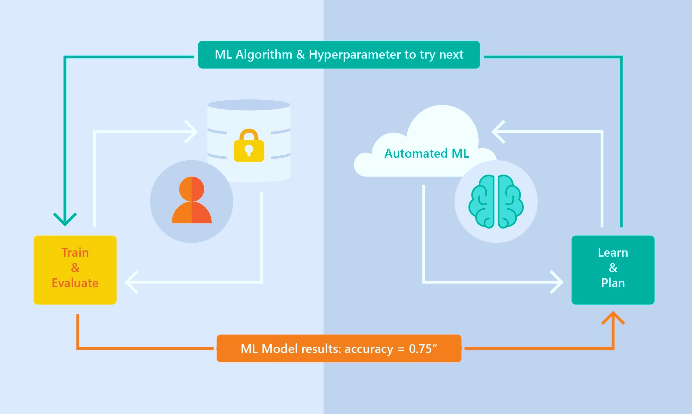
Automated ML Capabilities
Based on Microsoft Research
Brain trained with several million experiments
Collaborative filtering and Bayesian optimization
Privacy preserving: No need to “see” the data

Slide 7
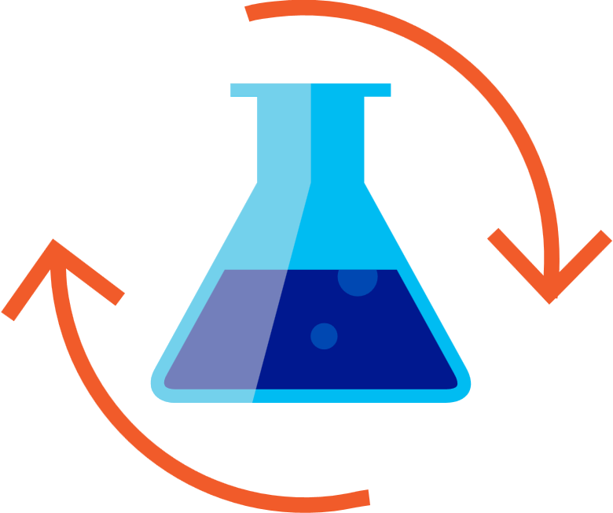

Machine Learning Process
SQL DB
Cosmos DB
Datawarehouse
Data lake
Blob storage
…
Prepare Data
Build & Train
Deploy

Slide 8
Machine Learning Problem Example
How much is this car worth?

Slide 9
Model Creation Is Typically Time-Consuming
Which features?
Which algorithm?
Which parameters?
Mileage
Condition
Car brand
Year of make
Regulations
…
Gradient Boosted
Nearest Neighbors
SVM
Bayesian Regression
LGBM
…
Parameter 1
Parameter 2
Parameter 3
Parameter 4
…
Mileage
Gradient Boosted
Criterion
Loss
Min Samples Split
Min Samples Leaf
Others
Car brand
Year of make
30%
Model

Slide 10
Model Creation Is Typically Time-Consuming
Which features?
Which algorithm?
Which parameters?
Mileage
Condition
Car brand
Year of make
Regulations
…
Gradient Boosted
Nearest Neighbors
SVM
Bayesian Regression
LGBM
…
Criterion
Loss
Min Samples Split
Min Samples Leaf
Others
Mileage
Gradient Boosted
N Neighbors
Weights
Metric
P
Others
Condition
Nearest Neighbors
Car brand
Car brand
50%
Year of make
30%
Year of make
Model
Iterate

Slide 11
Model Creation Is Typically Time-Consuming
Which features?
Which algorithm?
Which parameters?
30%
50%
70%
30%
45%
50%
65%
95%
35%
10%
75%
20%
70%
30%
15%
Iterate

Slide 12
Automated ML Accelerates Model Development
Input
Intelligently test multiple models in parallel
Output
25%
Optimized model
25%
40%
Enter data
70%
25%
40%
70%
95%
95%
Define goals
25%
40%
70%
25%
40%
25%
70%
Apply constraints
40%

Slide 13
Automated ML
Data
Feature
Algorithm
Tuning
Ranking
Explaining
☑
☑
☑
☑
☑
☑
Data cleaning support
Feature engineering
Pick and play
What to leave out
Ranking
Justification
Automated ML currently supports automated data cleaning
Most time consuming part when done manually can now be done within minutes.
Testing many different algorithms at once.
Hyperparameter tuning: what to include what to leave out
Having an overview of the best performing models based on accuracy & speed.
Being able to explain what created an outcome and what features had the most significant impact

Slide 14




Microsoft Automated ML Differentiators
Azure Cloud offering
Data privacy
Integration with data platforms
Meta-learning
Is a part of Azure Cloud
no data movement needed
ex: PowerBI, SQL, CosmosDB
gets better with customer usage

Slide 15
Automated ML Customer Testimonials
“I quite like your AutoML function. It gives me good results compared to other libraries I tested before (tpot and auto-sklearn) that I believe was only looking at scores and often gave me models that over-trained my data. And of course the model from your suggested code is better.”
- Big oil company
“I will start with AutoML and use the algorithm that AutoML recommends to further tune the model”
- Data Scientist
“I actually enjoy being able to use AutoML in a Jupyter notebook. The DataRobot interface was nice for non-experts, but for someone like me, it felt a bit basic.”
- Data Scientist
Press-coverage from public preview:
CNET
VentureBeat
PRNewswire

Slide 16
Automated ML Capabilities
ML Scenarios: Classification & Regression, Forecasting*
Integration: Azure Machine Learning, Azure Notebooks, Jupyter Notebooks
Data Type: Numeric, Text
Languages: Python SDK for deployment and hosting for inference
Training Compute: Local Machine, Data Science Virtual Machine (DSVM), Azure Databricks*
Transparency: View run history, model metrics
Scale: Faster model training using multiple cores and parallel experiments
* In Preview

Slide 17
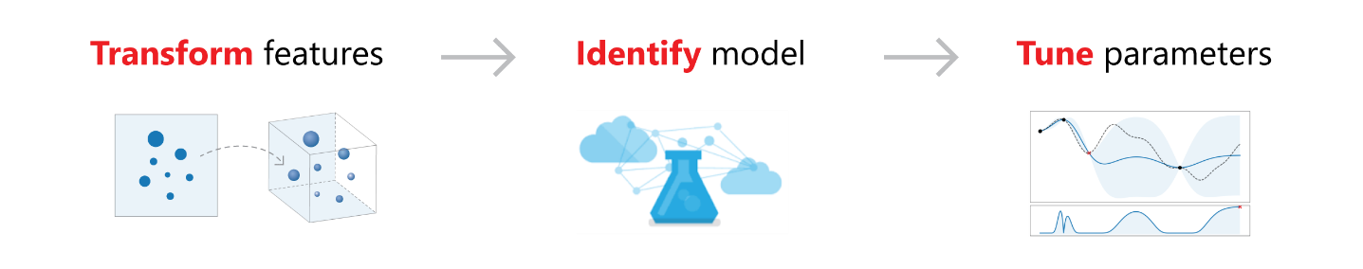
Feature Engineering
Dropping high cardinality or no variance features
Features with no useful information are dropped from training and validation sets. These include features with all values missing, same value across all rows or with extremely high cardinality (e.g., hashes, IDs or GUIDs).
Missing value imputation
For categorical features, missing values are imputed with most frequent value. For numerical features, missing values are imputed with average of values in the column
Generating additional features
For DateTime features: Year, Month, Day, of week/ of year, Quarter, Week of the year, Hour, Minute, Second.
For Text features: Term frequency based on word unigram, bi-grams and Char tri-char, Count vectorizer
Transformations and encodings
Numeric features with very few unique values are transformed into categorical features. Depending on cardinality of categorical features label encoding or (hashing) one-hot encoding is performed

Slide 18
Preview Features Updates
Model Explain-ability
Azure Databricks
Feature importance as part of training
Simple UX for feature importance for a selected iteration
Local feature importance for a given sample
Azure Databricks integration
Improved Performance
Support Remote Compute
Raw Feature importance
Prediction time feature importance
Roadmap
Parallel run of iterations on Azure Databricks cluster
Support for latest Azure Databricks 4.x and 5.x non-ML runtimes
Easy install on Azure Databricks cluster with a single integrated automated ML & AML SDK package
Roadmap
Azure Databricks integration
Improved Performance
Support Remote Compute
Raw Feature importance
Prediction time feature importance
Forecasting
Grain Index Featurization & Grouping
Missing row imputation, including target column
Improved time index featurization
Guidance on time-series specific train/validation/test split
Drop Column
Roadmap
Confidence Interval
Lag & Rolling Window
Rolling Origin Cross Validation
External Dataset
Cross Time Predication

Slide 19

Workshop

Slide 20
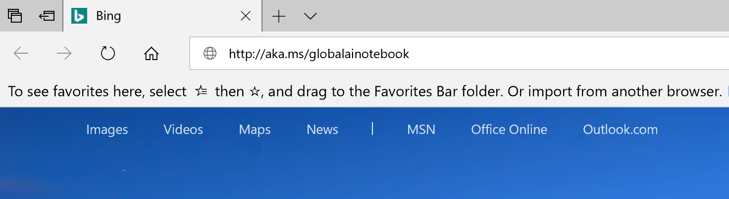
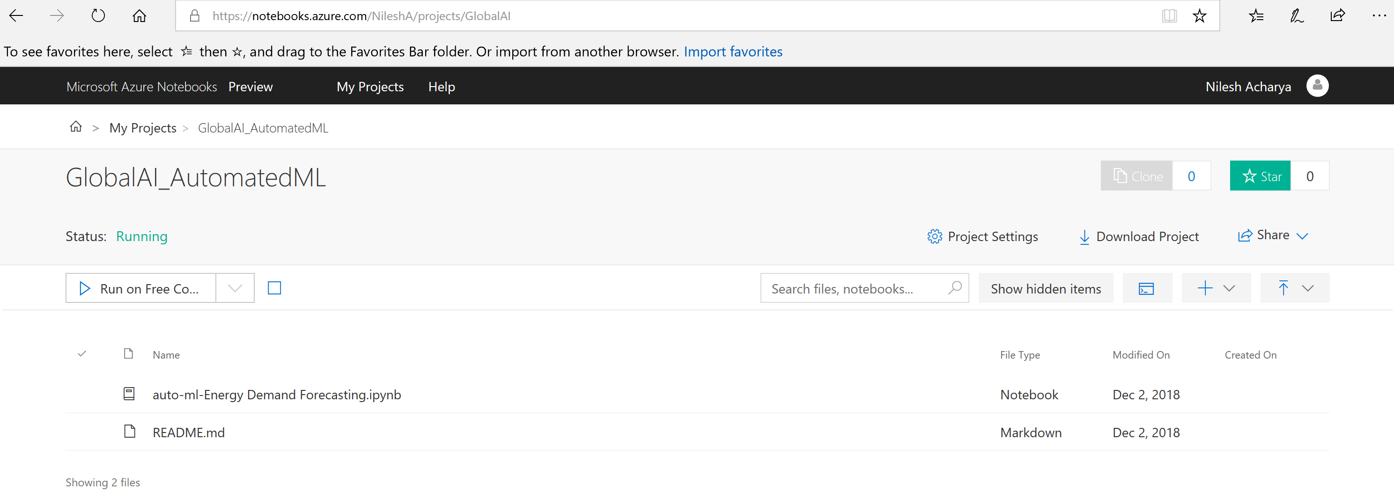
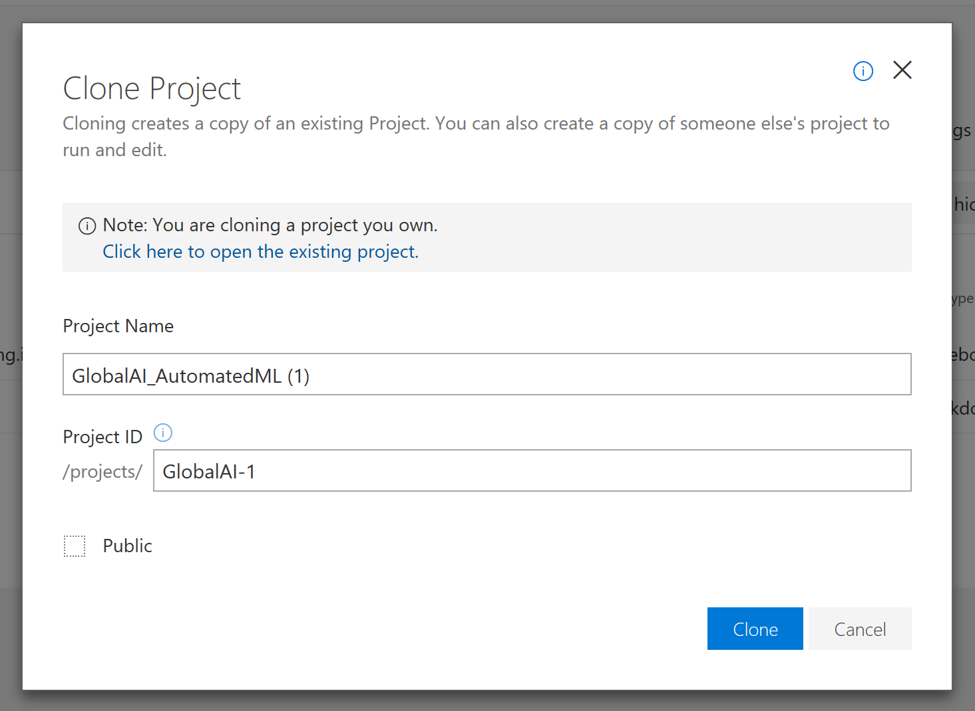
1. Select your workshop sample > Energy Demand : aka.ms/GlobalAINotebook > NASA Predictive Maintaince : aka.ms/GlobalAINotebook2
2. Click on Clone
3.Enter Project name, Project ID and uncheck Public tick box
4. Open notebook and follow instructions
Notes:
NASA Notebook : https://notebooks.azure.com/deepak-notebook/projects/predmaint/html/Predictive%20maintenance%20NASA%20sample.ipynb

Slide 21
Resources
Product Feedback : AskAutomatedML@microsoft.com
Documentation
Sample notebooks
Blog

Slide 22
Thank You!
AI Platform Team

